Slide 1
MGB1121/ CGB1122/EGB1121 – DATA STRUCTURES PROJECT REVIEW-3
Academic Year: 2025 – 2026 (Even Semester)
Register Number :927625BSC001,927625BCS138,927625BCS180
Section Roll Number :A601,A649,A662
Name :AJAY S, SABARISHWARAN P, VIMAL S
Year : I
Semester : II
Section : A6
Date : 22-04-2026

Slide 2
Project Title
WATER FLOW STIMULATION IN PIPES

Slide 3
ABSTRACT
The project presents the design and development of a Simulation of Water Flow in Pipes using Data Structures, focusing on efficient flow analysis and visualization through graph-based techniques. A Graph data structure is used to represent the pipe network, where nodes denote junctions and edges denote pipes. The system follows a role-based approach, where administrators manage the pipe network by adding or deleting connections, while users can run simulations between selected nodes. Dijkstra’s Algorithm is implemented to determine the shortest time path for water flow between nodes. The simulation calculates flow time using parameters such as pipe length and velocity, and visually represents the movement of water through animated interfaces. The system includes a role-based authentication mechanism to ensure secure access and controlled modifications. Additionally, the application integrates real-life use cases such as water supply systems and irrigation. By combining data structures, algorithms, and interactive visualization, the project demonstrates the real-world applicability of computational techniques in fluid flow management systems.

Slide 4
ABSTRACT WITH CO & PO MAPPING
Abstract | CO | PO
The project presents the design and development of a Simulation of Water Flow in Pipes using Data Structures, focusing on efficient flow analysis and visualization through graph-based techniques. A Graph data structure is used to represent the pipe network, where nodes denote junctions and edges denote pipes. The system follows a role-based approach, where administrators manage the pipe network by adding or deleting connections, while users can run simulations between selected nodes. Dijkstra’s Algorithm is implemented to determine the shortest time path for water flow between nodes. The simulation calculates flow time using parameters such as pipe length and velocity, and visually represents the movement of water through animated interfaces. The system includes a role-based authentication mechanism to ensure secure access and controlled modifications. Additionally, the application integrates real-life use cases such as water supply systems and irrigation. By combining data structures, algorithms, and interactive visualization, the project demonstrates the real-world applicability of computational techniques in fluid flow management systems. | CO1 CO2 CO3 CO4 | PO1 PO3 PO4 PO5

Slide 5
INTRODUCTION
The "Water Flow Simulation in Pipes" project is designed to model and analyze the movement of water through a network of interconnected pipes using Data Structures.
In real-world systems such as water supply networks, irrigation systems, and drainage systems, understanding the flow path and travel time of water is very important.
In this project, a graph-based approach is used where junctions are represented as nodes and pipes are represented as edges. The system calculates the shortest path and minimum time required for water to travel from a source node to a destination node using Dijkstra's Algorithm.The system follows a role-based approach where only the Administrator can modify the pipe network by adding or deleting pipe connections, while Users can run simulations between selected nodes.The main aim of this project is to demonstrate how Data Structures and Algorithms can be applied to solve real-world engineering problems efficiently.

Slide 6
DATA STRUCTURES USED
Graph (Adjacency List)
Represents the pipe network
Nodes → Junctions
Edges → Pipes
Priority Queue
Used in Dijkstra’s Algorithm
Helps select the node with minimum distance
Array
Stores distance values and visited status
Queue (Optional for BFS visualization)
Used for flow animation or traversal

Slide 7
ADVANTAGES
Efficient calculation of shortest path
Real-time simulation of water flow
Helps in planning water distribution systems
Reduces manual calculation errors
Scalable for large pipe networks
Easy visualization of complex systems

Slide 8
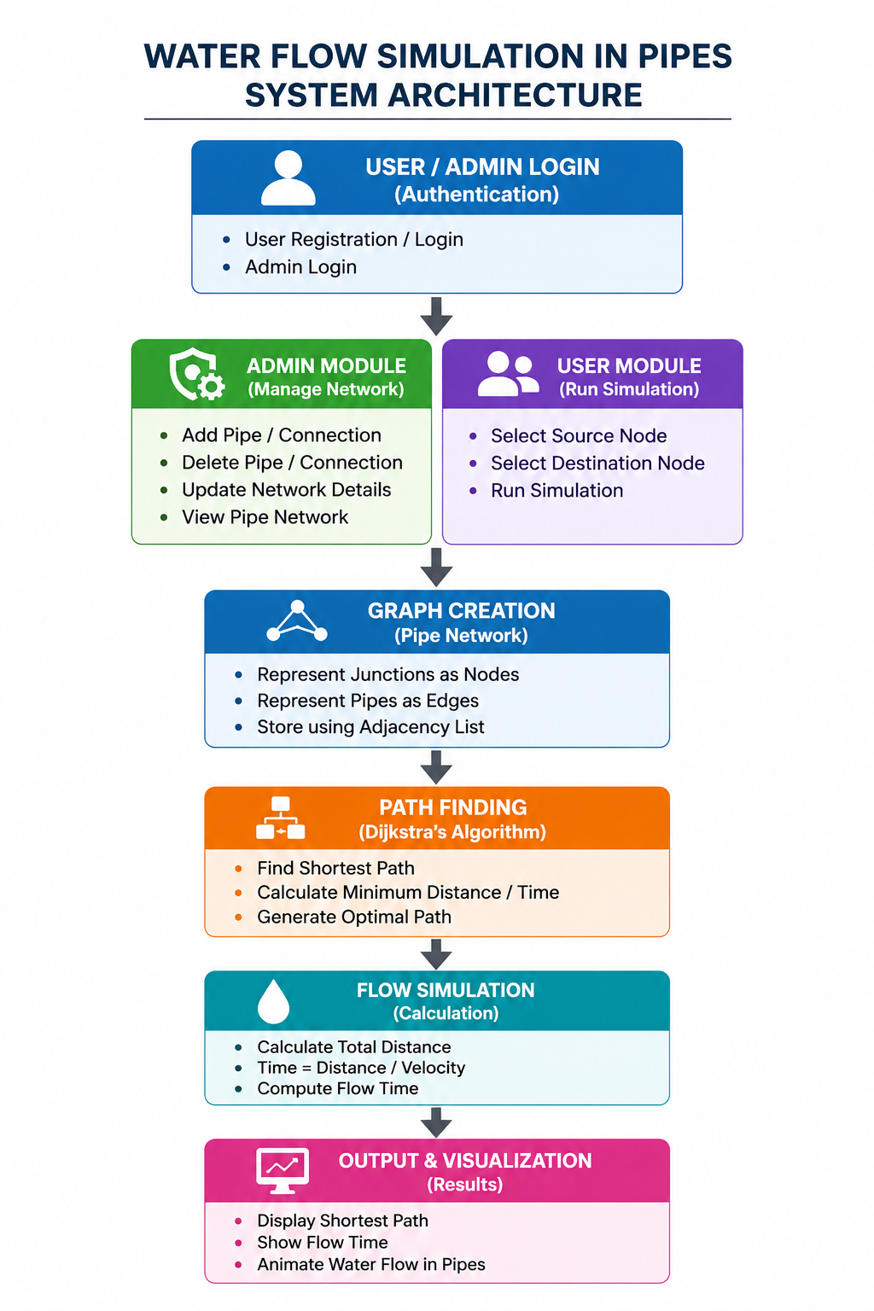
BLOCK DIAGRAM

Slide 9
BLOCK DIAGRAM - DESCRIPTION
User/Admin Login: Secure authentication to access the system.
Admin Module: Manages pipe network by adding or deleting connections.
User Module: Selects source and destination nodes to run simulation.
Graph Creation: Creates the pipe network using nodes and edges.
Flow Simulation: Calculates water flow time.
Dijkstra's Algorithm: Finds the shortest path between selected nodes.
Output & Visualization: Displays the shortest path and simulation results

Slide 10
LIST OF MODULES
Authentication Module
Admin Module
User Module
Graph Creation Module
Path Finding Module
Flow Simulation Module
Visualization Module

Slide 11
MODULE DESCRIPTION
1. Authentication Module
Handles User Registration and Login
Provides Secure Access Control
2. Admin Module
Add Pipe Connections
Delete Pipe Connections
Update Network Information
View Complete Pipe Network
3. User Module
Select Source Node
Select Destination Node
Execute Water Flow Simulation
4. Graph Creation Module
Creates Nodes and Edges
Stores Pipe Network using Adjacency List

Slide 12
MODULE DESCRIPTION(CONT…)
5.Path Finding Module
Implements Dijkstra's Algorithm
Determines Shortest Path
Calculates Minimum Distance
6. Flow Simulation Module
Calculates Water Flow Time
Formula:
Time = Distance / Velocity
Computes Overall Flow Duration
7. Visualization Module
Displays Shortest Path
Shows Water Flow Animation
Displays Simulation Results

Slide 13
RESULTS AND DISCUSSION
Role-Based Access improves security.
Unauthorized users cannot modify network data.
Graph representation efficiently models pipe systems.
The system can be extended to real-world water distribution networks.
Dijkstra's Algorithm ensures optimal route selection.

Slide 14
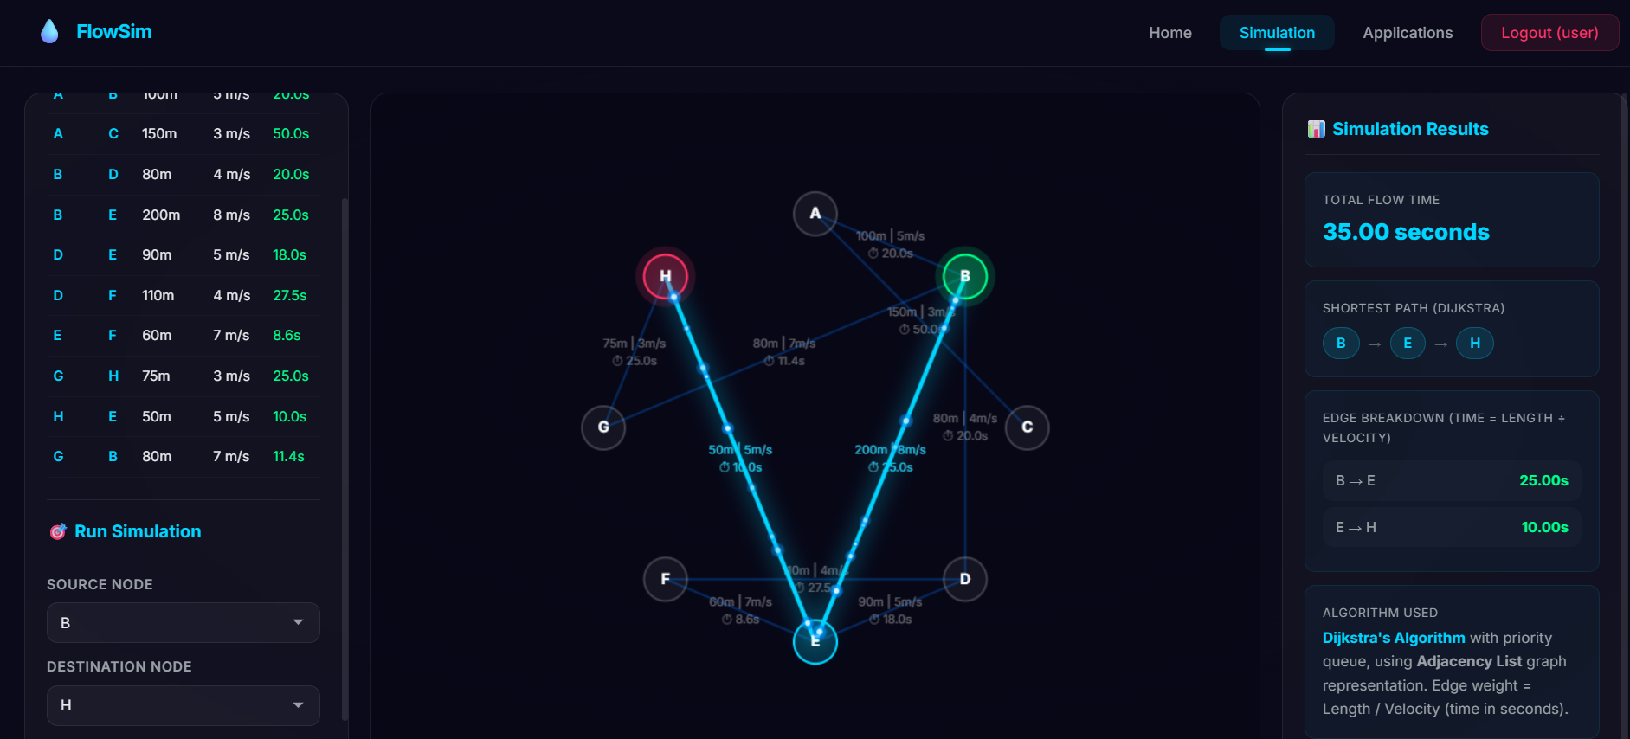
RESULTS AND DISCUSSION(CONT…)

Slide 15
CONCLUSION
The project demonstrates the practical application of Data Structures and Algorithms in water flow management systems.
The pipe network is represented using Graphs, while Dijkstra's Algorithm is used to determine the shortest path and minimum travel time.
The role-based architecture allows Administrators to manage the network and Users to perform simulations, improving security and usability.
Future enhancements can include real-time sensor integration, pressure calculations, and advanced industrial-level simulations.

Slide 16
REFERENCES
Data Structures by Seymour Lipschutz
Introduction to Algorithms by Thomas H. Cormen
GeeksforGeeks (www.geeksforgeeks.org)
W3Schools (www.w3schools.com)
Research papers on water distribution systems

Slide 17
Thank You!!

